Slide 1
Microcontroller & Interfacing Sessional Project Name: Quadruped Spider Robot
ID – 2008001,
2008002,
2008005,
2008023,
2008059
Submitted to
MD. Sakib Hasan Chowdhury
Lecturer
Department of Mechatronics Engineering
Rajshahi University of Engineering Technology

Slide 2
Introduction
What is Quadruped Spider Robot?
A quadruped spider robot is a four-legged walking machine inspired by the movement of real spiders, designed to mimic their agility and versatility. The robot's legs are arranged in a way that allows it to perform a range of actions, including walking, running, and even Rotating.
Quadruped Spider Robot

Slide 3
Features
The Quadruped Spider-bot is an incredibly versatile robotic system designed to navigate challenging environments and perform a variety of critical tasks. Here are some of its key capabilities:
Hazardous Region Exploration: The Spider-bot can safely traverse dangerous areas, making it ideal for examining hazardous sites or investigating hard-to-reach chambers.
Post-Earthquake Assessment: After earthquakes, it can inspect risky sand structures, ensuring stability and safety in damaged areas.
Munitions Detection: The robot is equipped to search for and deactivate munitions, such as landmines, helping to secure and clear dangerous zones.
Payload Flexibility: The Spider-bot can be easily modified to carry various payloads, including sensors, actuators, or even small carriages, making it adaptable for different missions.
Quadruped Spider Robot

Slide 4
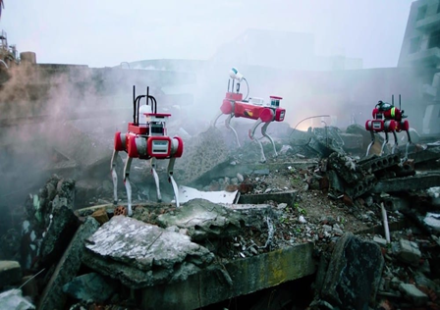
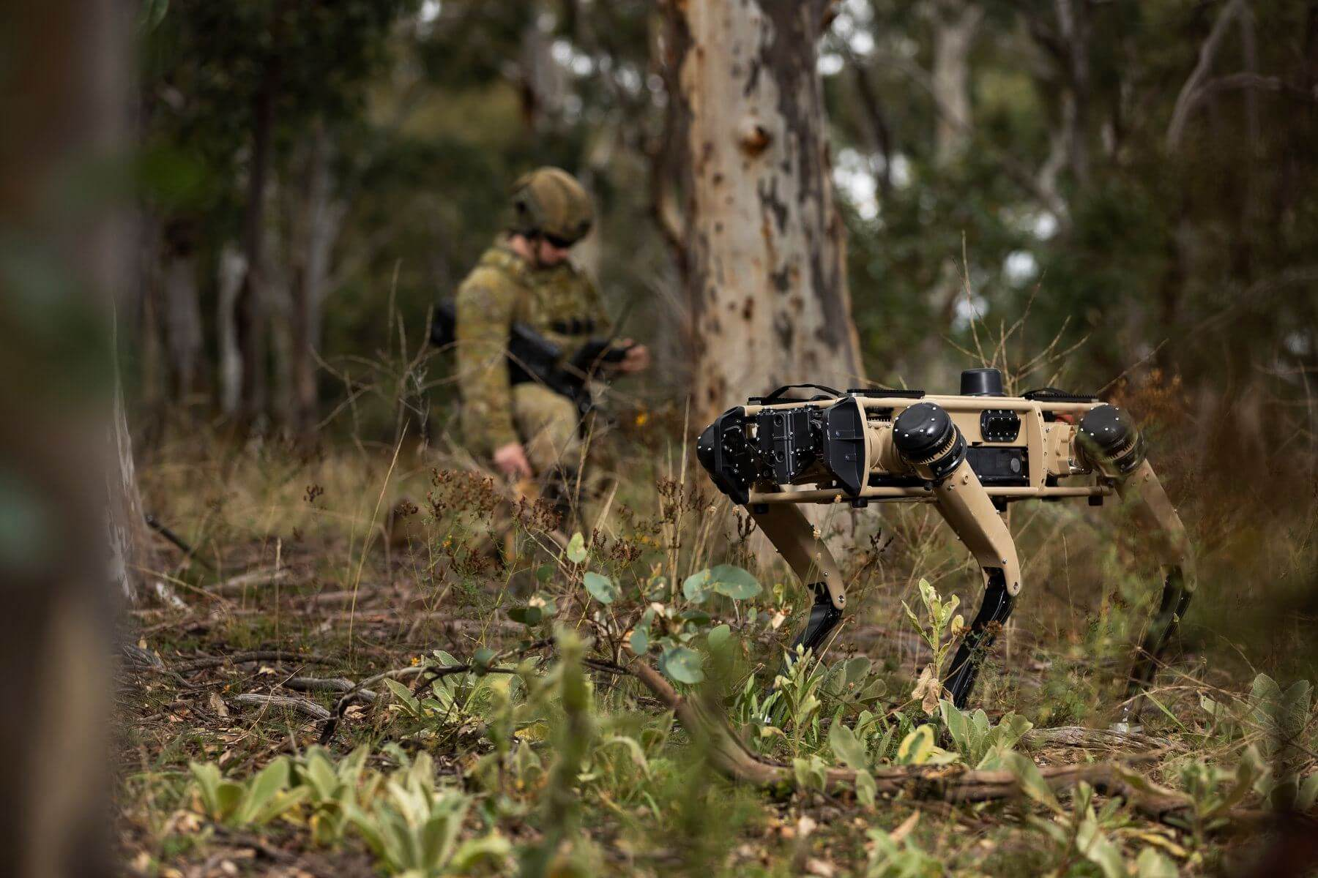
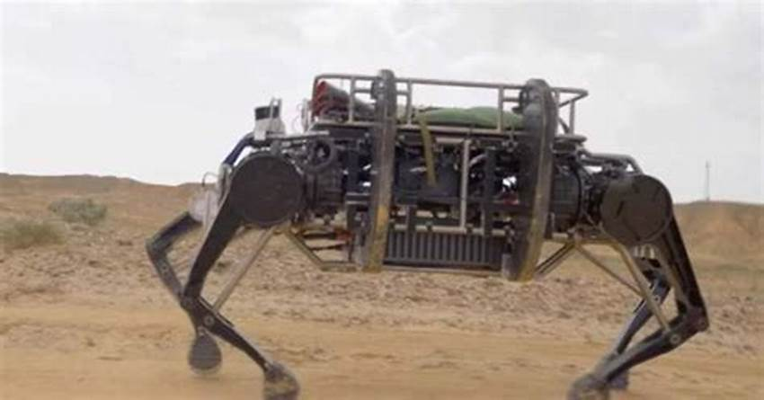
Features
Expeditionary Missions: In outer planetary missions, it can serve as an expeditionary vehicle, collecting data and exploring uncharted territories.
Advanced AI Integration: These robots utilize sophisticated AI algorithms and motion planning systems, allowing them to adapt seamlessly to their environment. Real-time feedback from sensors helps maintain balance and optimize leg movements, ensuring stable navigation over uneven terrain.
Fig: Some Action of Quadruped Robot
Quadruped Spider Robot

Slide 5
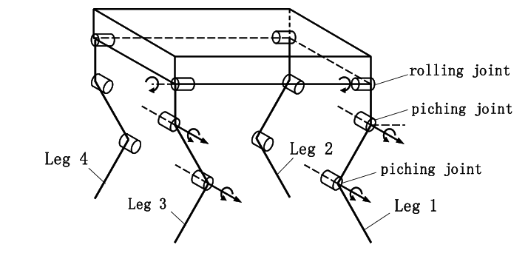
Technical Specification
The robot has a total of.12 degrees of freedom (facilitated by 12 servos), with each leg having 3 degrees of freedom. Which means that it can move 12 different joints in different positions.
Legs are positioned symmetrically on both sides. and Servo motors provide movement of joints.
Servo motors that connect the legs to the body allow it to rotate sideways.
The other two servo motors provide movement of the joints.
Fig: Schematic Diagram of Spider Robot
Quadruped Spider Robot

Slide 6
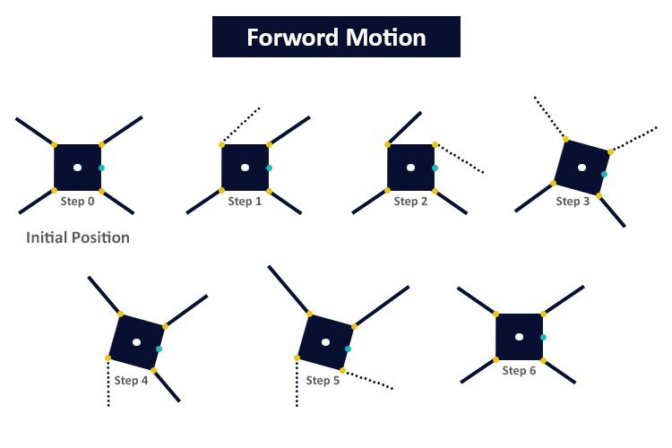
WALKING THEORY
Forward Motion:
Quadruped Spider Robot

Slide 7
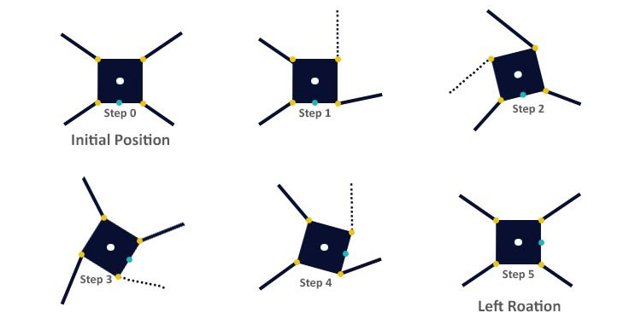
WALKING THEORY
Left Motion:
Quadruped Spider Robot

Slide 8
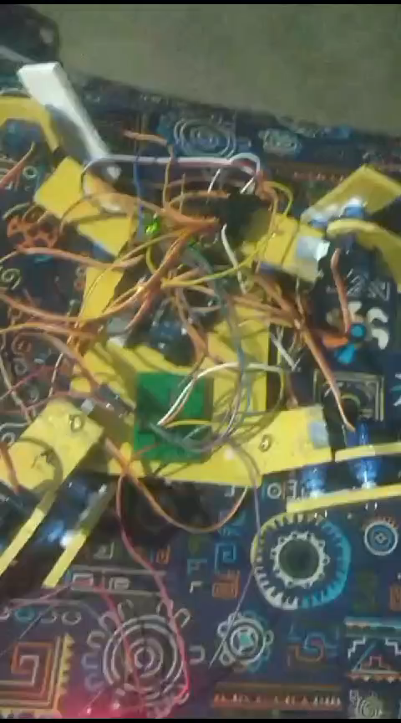
Operation Demo
Quadruped Spider Robot

Slide 9
HARDWARE SPECIFICATIONS
Arduino Uno.
Servo – Tower Pro SG-90 x 12.
DC-DC buck converter – 12V
PVC board ( Structure )
Screw joints
Quadruped Spider Robot

Slide 10
Future scopes
Sensor Integration
Actuator integration
Improved payload
Full autonomous operation
Quadruped Spider Robot

Slide 11
Limitations
Complex developing procedure
Slow speed of forward movement
Requires significant effort to achieve stable performance
Complex calibration curve
The developed protype lacks sturdiness
Quadruped Spider Robot

Slide 12
Component Price
SG-90 Servo | 150x12= 1800 bdt
Arduino Uno | 950 bdt
DC-DC buck converter | 100 bdt
PVC board | 80 bdt
Screw joints | 80 bdt
Miscellaneous | 100 bdt
 | Total =3110 bdt
Quadruped Spider Robot

Slide 13
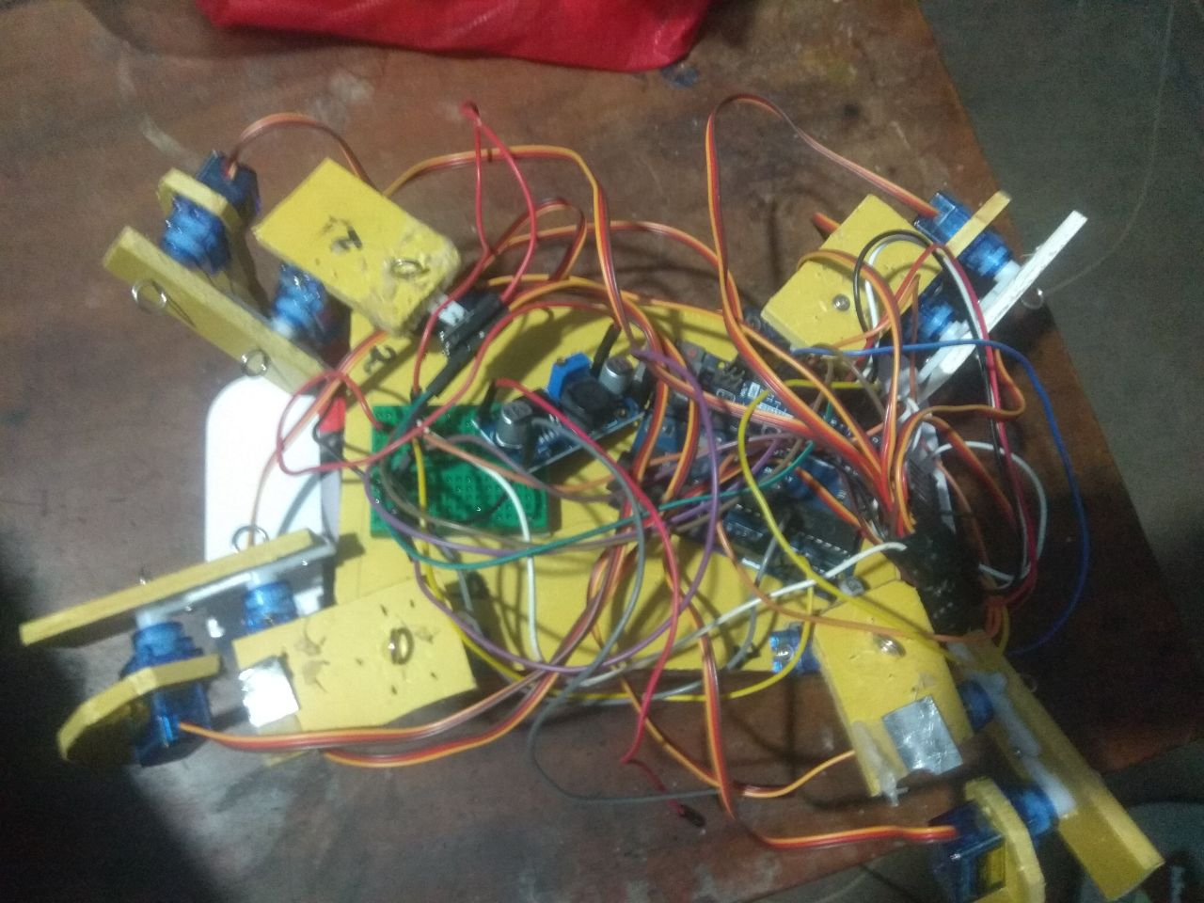
Outlook
Quadruped Spider Robot

Slide 14
Thank You
Any Question?

